Slide 1
WELCOME
TO
THE ENGLISH CLASS

Slide 2


Slide 3
Teacher Identification
Khalid Hossain
Lecturer, English
Moghia Salehia Alim Madrasha,
Kachua, Bagerhat.
Index No. 2028580
E-mail: khalid.apu@gmail.com

Slide 4
Lesson Introduction
Class : Eleven (11)
Subject : English 1st Paper
Topic : How to learn English
[ Unit 3, Lesson 3 ]
Time : 45 minutes
Date : 31st May 2013

Slide 5
Objectives
At the end of the lesson students will be able to
1. Analyse the difference between language & communication
2. Sort out ways about how one will learn English
3. Read a passage about ways you can learn English
4. Overview some process of learning
5. Write a letter of advice to someone

Slide 6

Describe the picture.

Slide 7

Describe the picture.

Slide 8

Describe the picture.

Slide 9
TOPIC
HOW TO LEARN ENGLISH

Slide 10
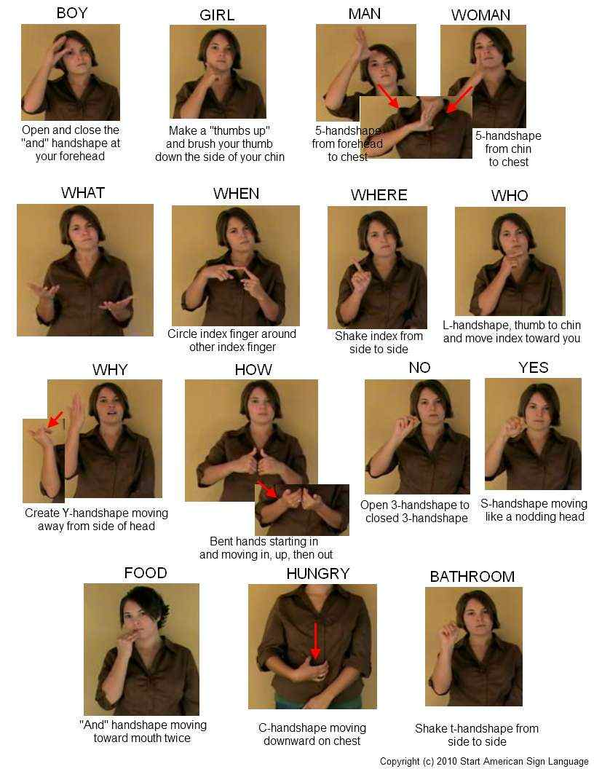
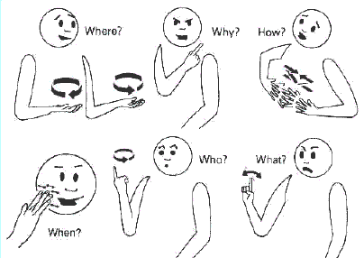
Communication
Sign Language

Slide 11



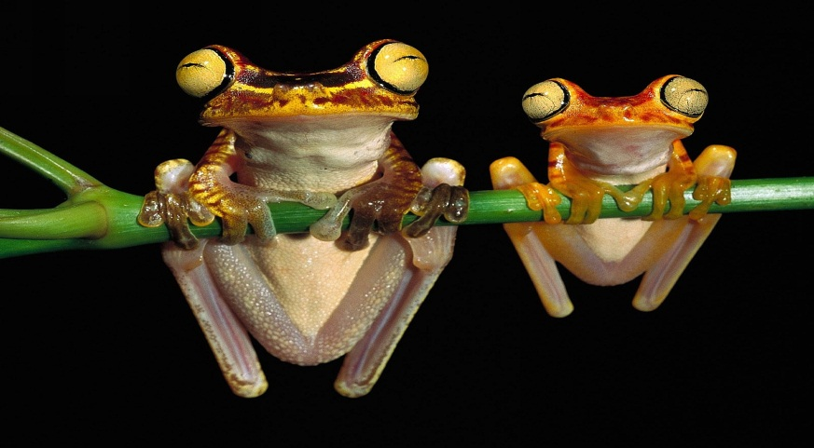
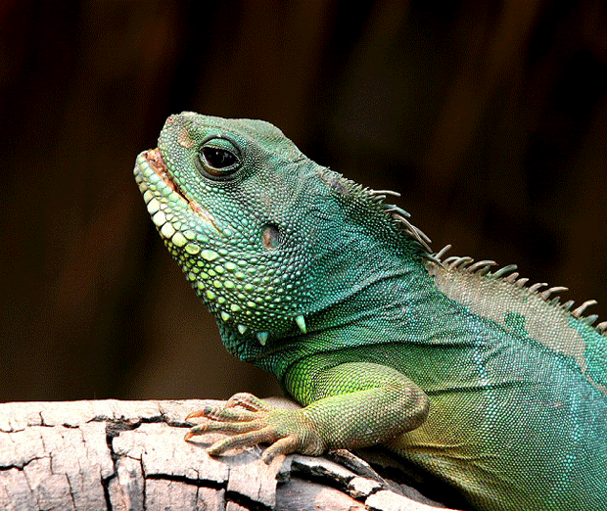
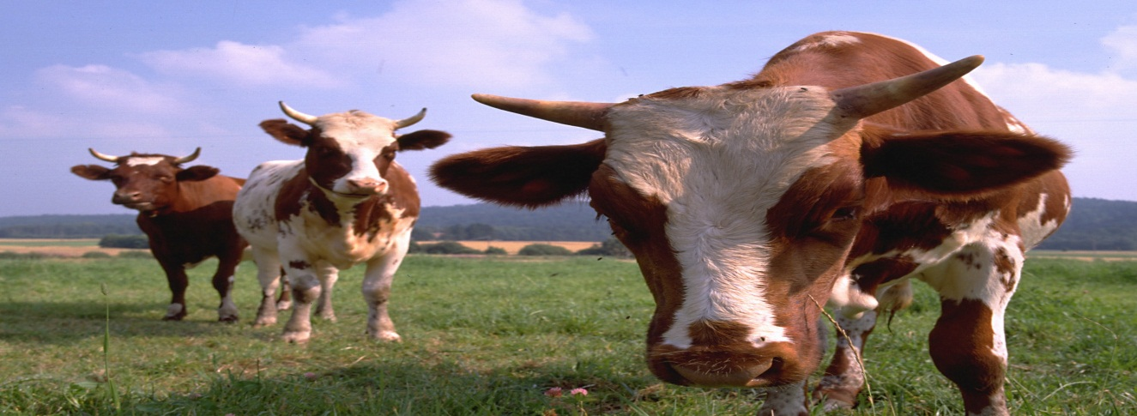
Communication
Sound

Slide 12
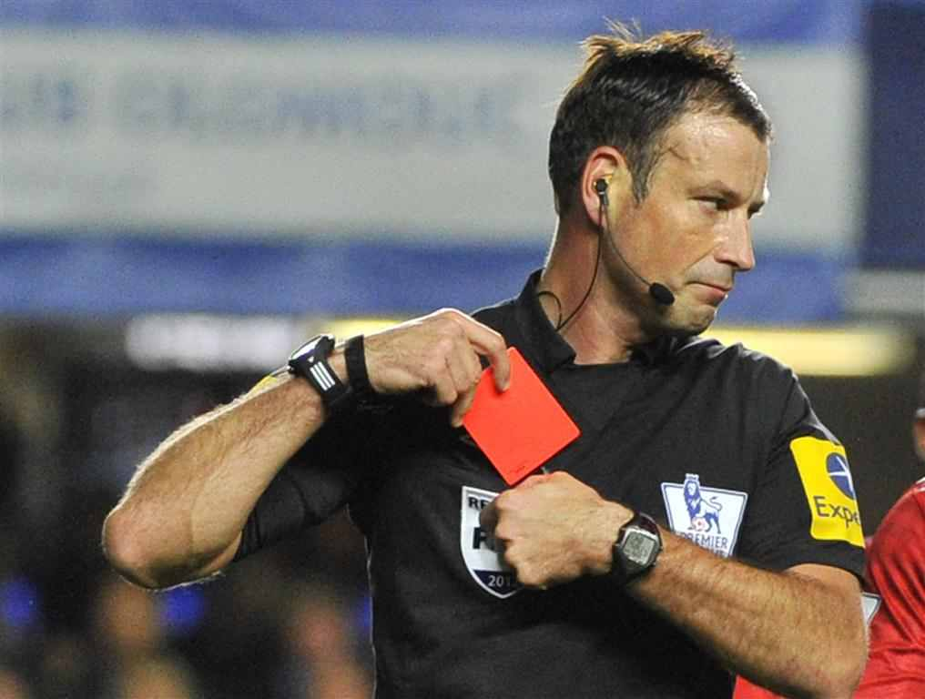
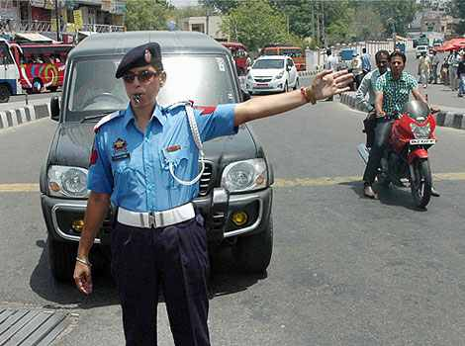
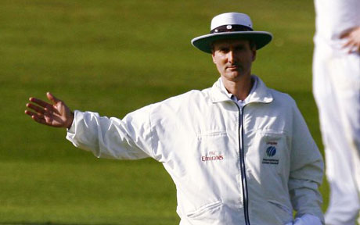
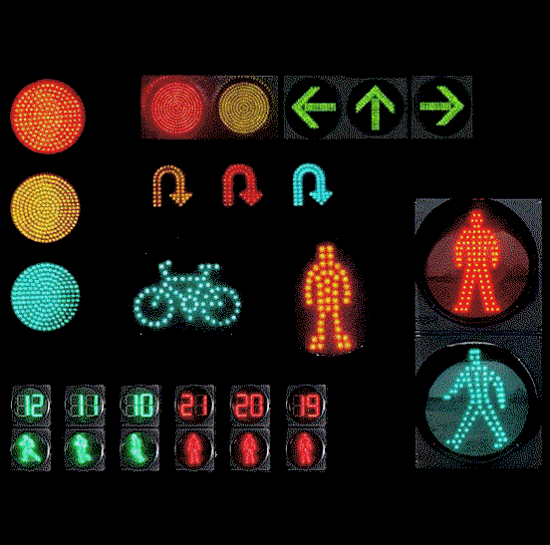
Communication
Sound/Sign

Slide 13
Warming up the class
Think about how you yourself learn English. Jot down a few points quickly and then compare them with those of other students in your group.
What is language?

Slide 14

Friends’ Talking

Slide 15
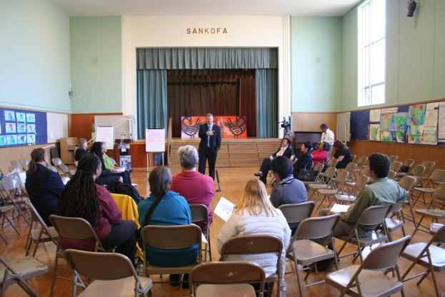
Teacher Talking in the classroom

Slide 16

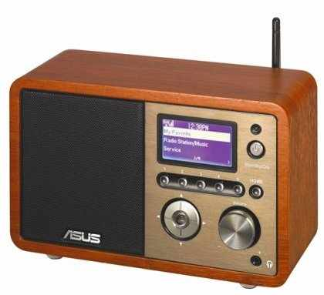
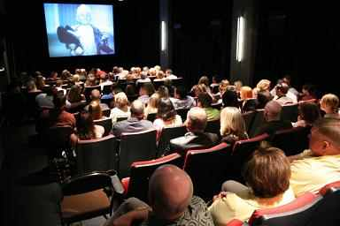
Watching TV
Listening Radio
Watching Movie

Slide 17

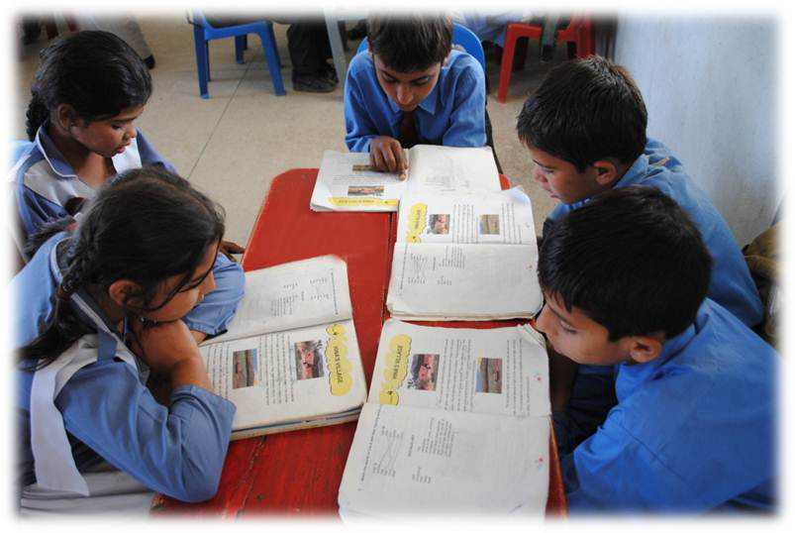

Reading Books

Slide 18
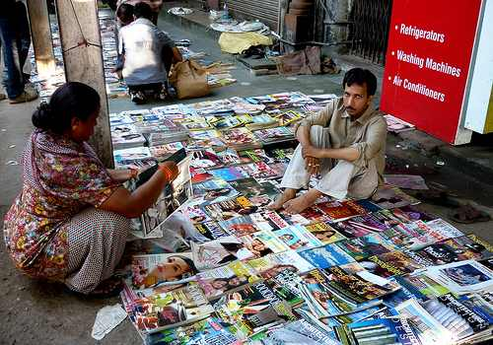



Reading Newspapers/Magazines

Slide 19

Using Computers/Internet

Slide 20


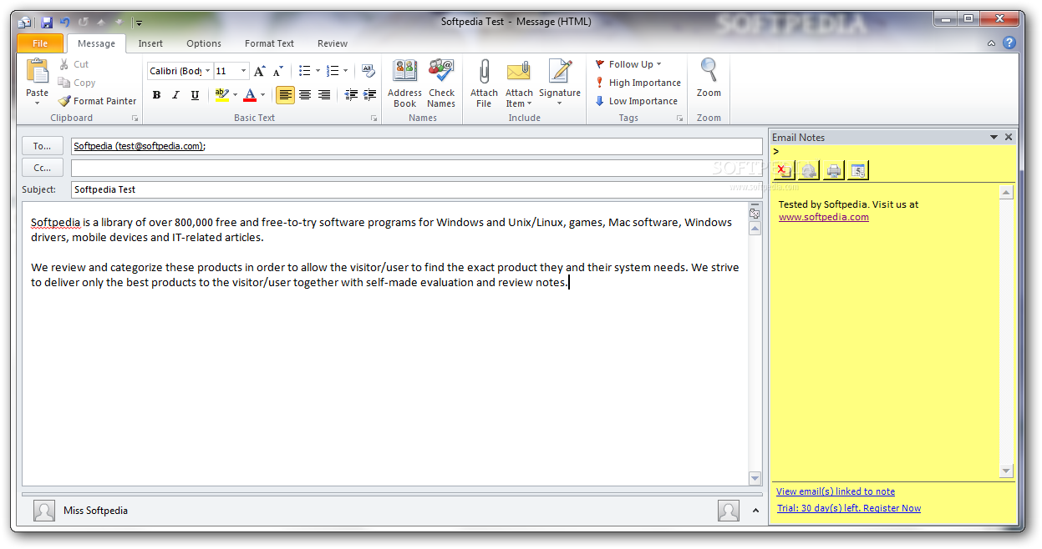
Write Letters/E-mails

Slide 21
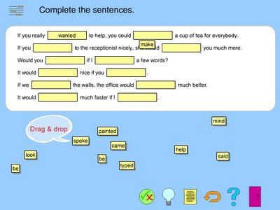
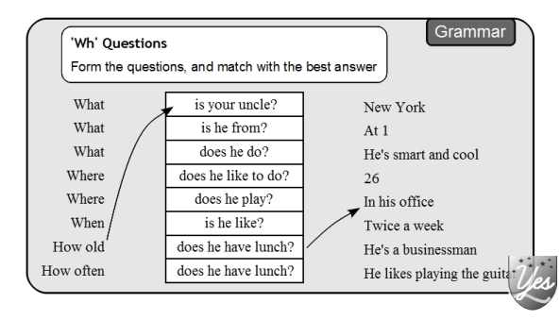
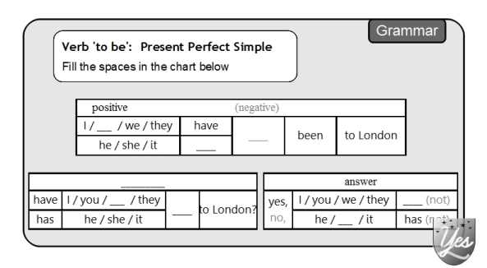
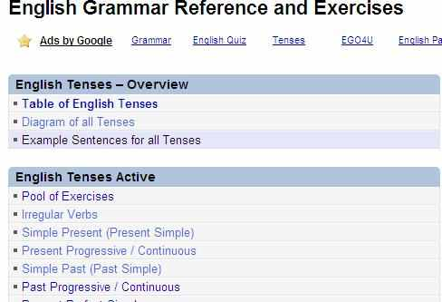
Practising Structures

Slide 22


Reading Grammar Books

Slide 23
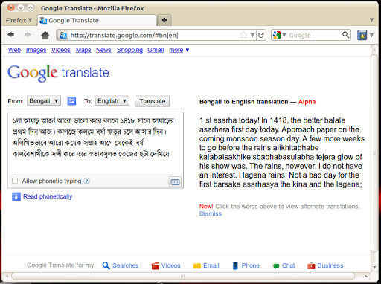
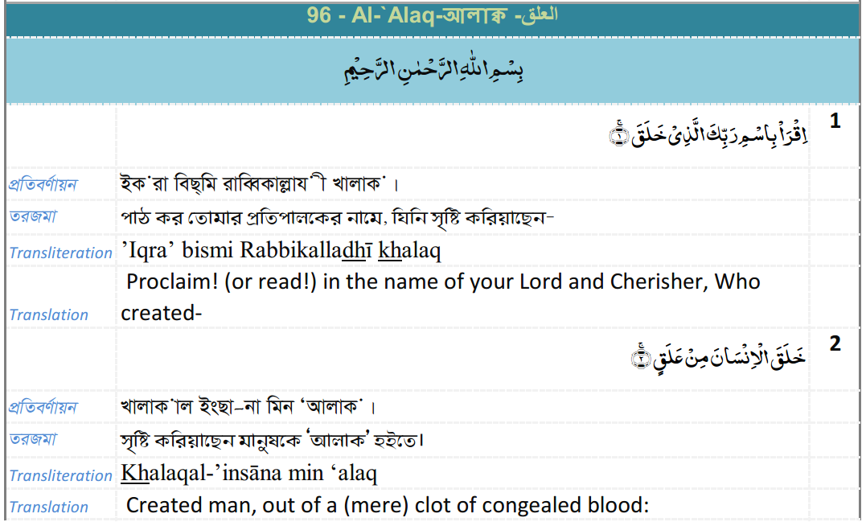
Doing Translation

Slide 24

Conversations in Different situations

Slide 25


Now check which of the following you do :
Talk with teachers/friends
Listen to the Radio
Watching Television
Watch English Films
Read English Textbooks
Read English newspapers/magazines
Write letters
Do grammar exercises
Read grammar books
Do translations
Memorize conversational English

Slide 26
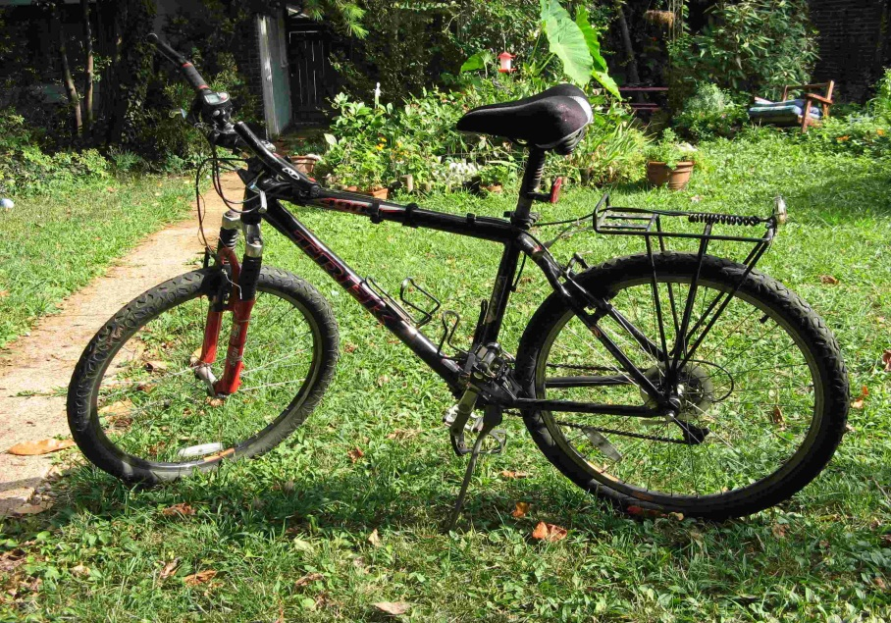
Bicycle

Slide 27


RAGHIB
ADEEB

Slide 28
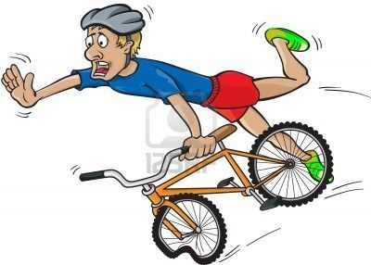
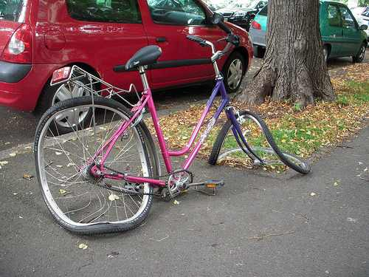



Slide 29


Group Work
1. Who is more practical among the two? How?
2. What was Adeeb’s problem in learning to ride a cycle?
3. How is learning a language similar to riding a cycle?
4. What is the writer’s attitude towards making mistakes? Are mistakes tolerated in your English class? What about in other class?

Slide 30



Assessment / Evaluation (Oral)
In not more than 5 sentences
You can learn to speak only by speaking
You can learn to listen only by listening
You can learn to read only by reading
You can learn to write only by writing

Slide 31
Home Work
Write a letter to your younger brother/sister/cousin giving some practical hints on how to improve his/her proficiency in English.
2. Write a paragraph giving advice to your friends about why they need English.

Slide 32

This is the end of today’s English lesson.
Thank you all.

